Slide 1
GST/n – A General Systems View of Natural Systems
Systems In-Context - Referred to by the Root Meanings Language
Weaving Abstract & Contextual Systems:
Telling Them Apart – & – Aligning Their Parts
A People’s Systems Science
sy@synapse9.com To schedule full small-group discussions of how to reconnect theory with nature
Here we’re asking:
What are the systemic meanings expressed by the roots of all languages?
Experiential knowledge is obtained from engaging with natural systems in context, responding to properties and principles found in practice.
Context is excluded from the otherwise wonderful insights with narrow definitions of abstract system thinking.
Might our split minds somehow fill each other’s gaps by connecting?
Might that help us get out of our present evolutionary trap and life crisis?
sy@synapse9.com
Jessie Henshaw Natural Systems Design Science - 10 June 2024

Slide 2
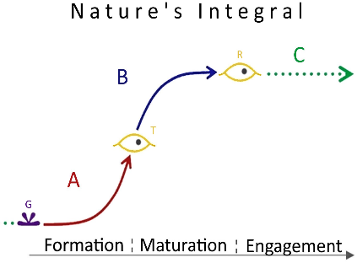
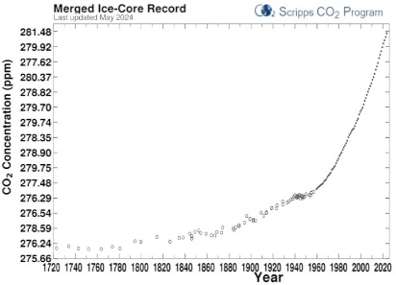
GST/n – For joining Abstract and Experiential Systems Thinking
Each used as a window on the other
Like the use of feeling on a subject to test reasoning and the reverse
2
What is the difference between abstract and experiential learning?
Comparing subject responses of each
Subjects | Abstract learner | Experiential learner | Combined
 | The shape is nice, but form and engagement have no scientific meaning | Thank you. It’s abstract, but it is also the story of how everything works. Now I know to look for the changes! | Oh my, both say. The abstraction helpd me look at the contexts and learn much more about how things work.
{co op er a tion} [com muni ca tion} | Interesting, I never realized words are geometries of meaning | I don’t get it. Why look at syllables when they’re just sounds put together? | Oh, I see. They are the most ancient meaningful sounds, put together to make rich pictures
 | This is a data curve with huge scientific meaning. It is the clear path to our future, but it must change somehow, too, but who knows how. | Oh, it’s so frustrating that nobody in charge seems to see how we’re destroying the planet so fast. | This is in everyone’s experience and works out fine if you just change from making to caring for things. Might we do that?

Slide 3
Each getting their say would imply
Three New Scientific Methods
Each working with a collaborator, And Together
Abstraction reconnecting with rich contexts (ending their blindness)
Experience discovering how local patterns fit and add up to big ones
3
For theorists, the most radical step may be simply taking an interest in a subject’s contexts, system self-animation, and opportunistic behavior.
Science finds so many useful rules, why be concerned with contexts?
- We rely on systems, and systems rely on their Contexts
- Contexts are also what cause systems pushed to their limits to so misbehave
Nature is so very “lively,” doesn’t it make sense to make that a subject, It’s where so many things go wrong, shouldn’t we study it?
How full of surprise nature is, after long silences responding energetically as things spring to life. What’s not to like?
- Don’t they self-animate by exploding their resources, what could go wrong?

Slide 4
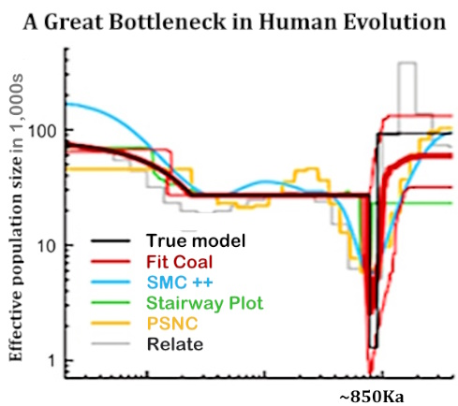
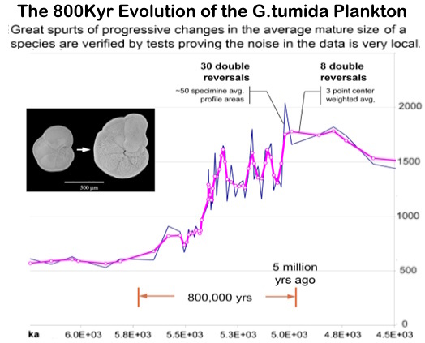
The Lively Stories of Transforming Natural Systems
(what puts the two together)
4
The populations of a half-dozen or so early hominid species collapsed in ~900ka, with only a tribe-sized number of our ancestors surviving.
The speciation of a larger plankton takes 800kyr, following an S-Curve of great leaps and collapses, until the greatest leap stabilizes halfway down.
The Bottleneck Emergence of Humanity (Hu et all. 2023) | The Try, Try, Again Emergence of a Plankton (Henshaw, 2007)

Slide 5
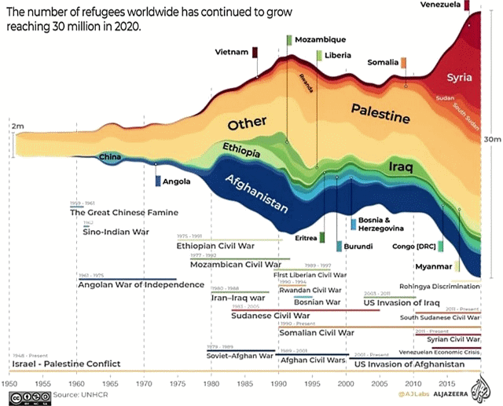
The Lively Stories of Transforming Natural Systems
5
Many of us recall the particulars of each new wave, wars, famines, and failing states. What else do we recall about the pressures that might be the cause?
What context caused them to build on each other? Would it have had to spread through the global system? It continues to rise. What cause and means could it be?
The world’s migration crises are continuing to grow, due to the pressure of growth on EVERYTHING

Slide 6
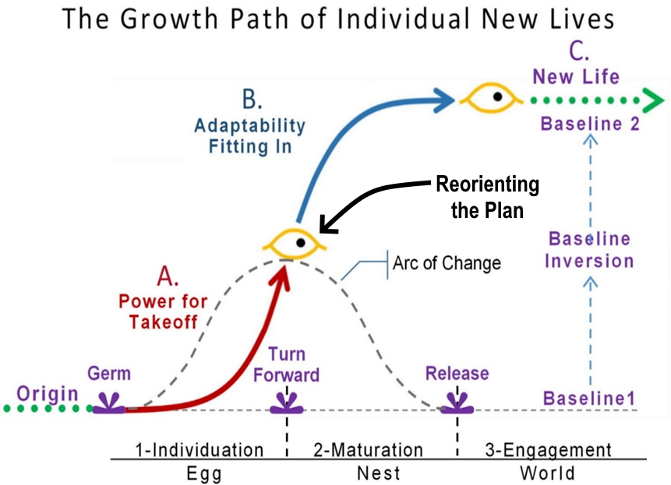
2-Noticing and responding to systems
6
Simple Abstract of the Minimal Stages of Emergence
― Going through them ourselves, what leads us through?? ―
Like at the midpoint turn, from startup to finishing a thought or task, what makes it feel it’s the right time?
Note: All systems have interior and exterior worlds
Moving resources from growth going to care of what growth built is how natural enduring systems work.
The system still needs profits for resilience to shocks and making collective choices about needs.
Sustainability and Impact Investing already do that, but neither would change the system.
So it’s really necessary for the elite managers to feel the threat to themselves and every one else.

Slide 7
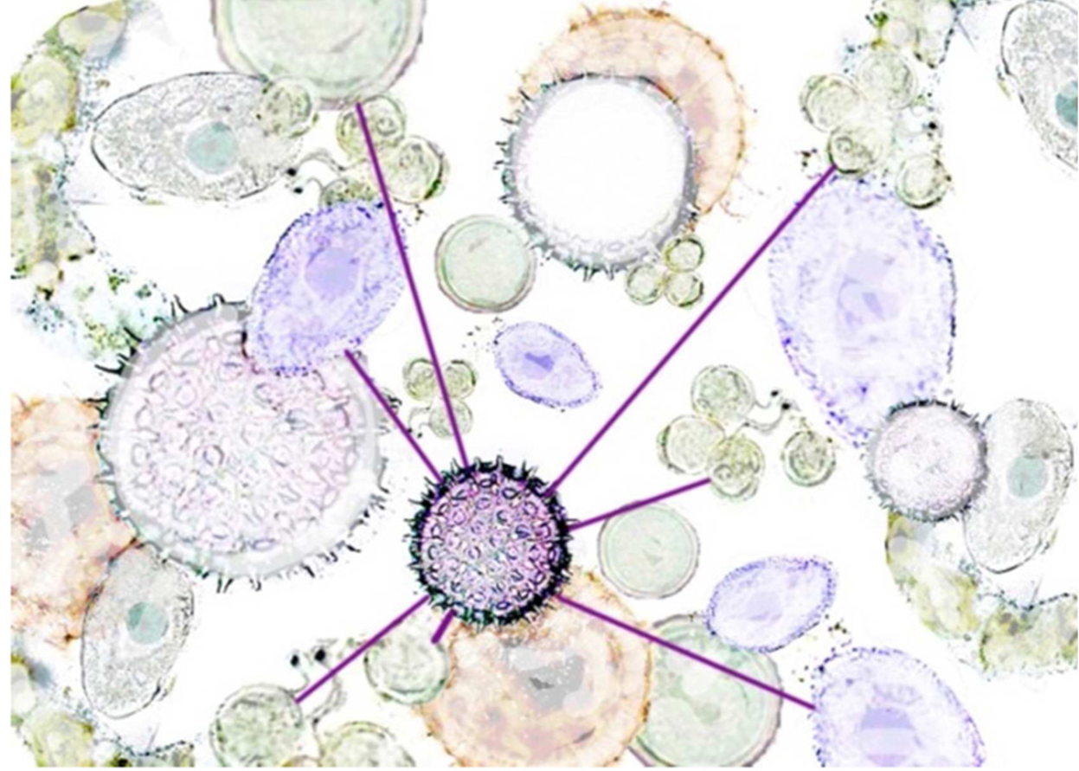
Reading life’s designs and changes emerging
Where do you see “animating seeds of growth”, creating “centers - with connections,” the central home-world creation process and design of life?
The animating center coupling with its context
capturing resources, building its organization to grow to its limits
Natural growth first multiplies the patterns of the seed, diversifying and expanding to its initial limits of its initial resource.
And after that explosive growth there is a change in plan, to perfecting the design as its limit to growth
Think of the center as an inside world connecting with its outside world
a

Slide 8
But…
What taught us today how to understand all this, all the complexity of life’s patterns and processes?
8
It seems to be language!
but where did such rich languages come from (?) to sometimes give any of us such deep insight into such incredibly diverse situations we may have never seen before?
What IS the magic behind it?
Isn’t it too big a design to design?
Jessie Henshaw Natural Systems Design Science - 10 June 2024

Slide 9
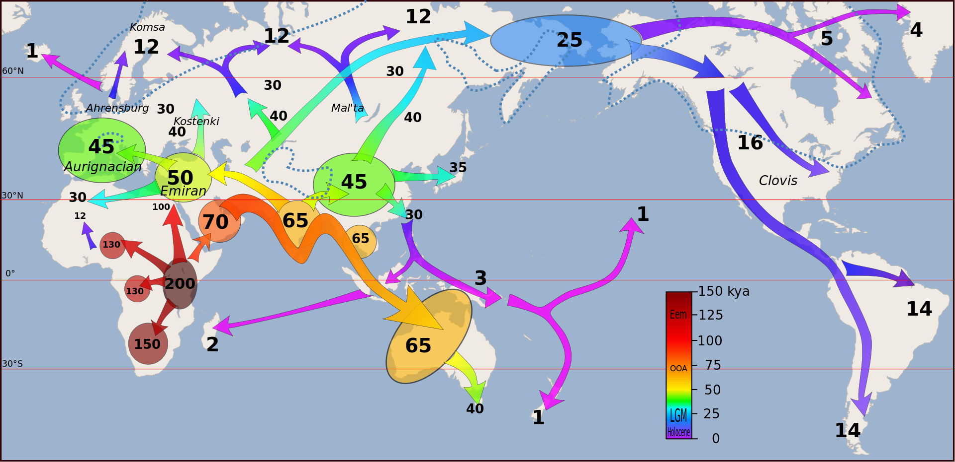
Our long exploration of life in nature’s systems
9
Our Foundational Indo-European Age of Travel, Craft, & Cross-Talk
People with common roots, doing, thinking, and making lives, building the now common world foundation of meaning.
wikipedia.org/wiki/List_of_first_human_settlements

Slide 10
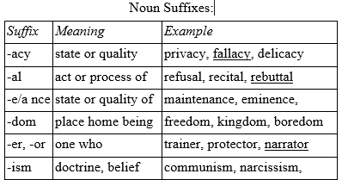
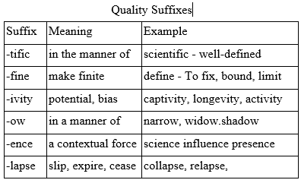
In travels back and forth, the networks shared
the sounds and gestures that best served the collective consciousness the subjects, prefixes, and suffixes emerged, as the new way to share deep knowledge.
10
the suffixes,
Add to the subject meaning tagged on the end,
the prefixes,
Add to the meaning added at the beginning,
To add the right nuances for:
relating to the context of the word’s use?
Where in the world did ALL that come from? It’s too big a design to design.

Slide 11
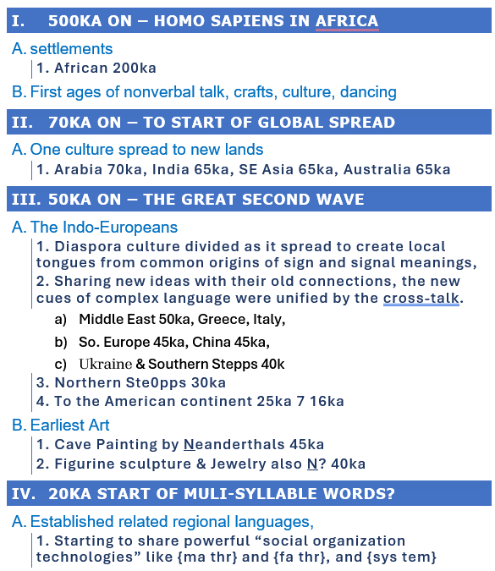
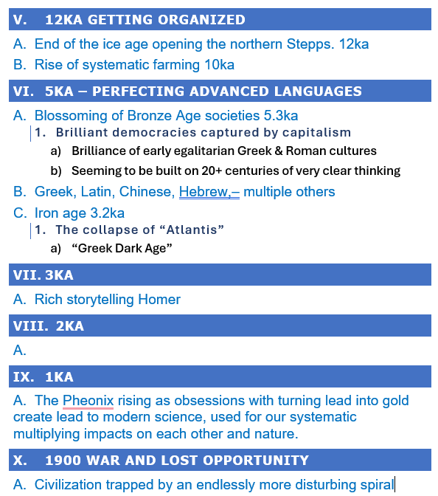
11
The foundation was ~200 kyr tribal life before
The great move of the explorers north, east, and west
Homo Erectus (2ma to 200ka) is the species that survived the 900ka weaning of human life
http://synapse9.com/ISSS-2024 EmergingSettlements&Language.htm

Slide 12
Reading natural systems in context
The communities that spread east and west of the Mediterranean appear to have all been aggressive learners, and all shared what they learned with their old networks, like:
Noticing changes “coming to a head” - requires intuitively reading the suddenness (accelerations) and sensing the system's instabilities for signs of how it will turn.
Noticing “changes in relationship” - anything changing from one form to another, like hesitations, interruptions, resistance, etc.- may indicate context change.
Noticing “ironies remaining unresolved” - indicates patches in a stable structure that might loosen or open, like smart leaders taking dumb paths or the reverse.
Think of descriptive words, study their syllables
And other words that use the same ones
And
Practice using words making material references to natural realities and experiences
To understand and be understood!

Slide 13
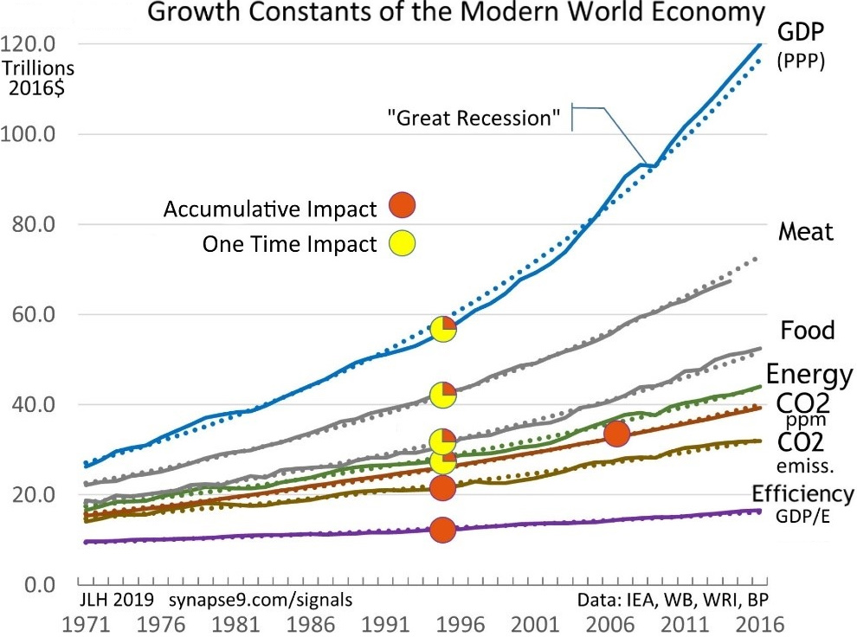
13
Reading the Economy’s Design, Centers, and Connections
Growing from centers of wealth and innovation all seeking the same thing, creating diverse branches all designed to fit together
to extend the original design and work as a whole,
aggressively scouring the Earth for anything it can use
… but not self-limiting, so less able to chart its future or sense threats to itself and its planet than a snow flakes or a slime mold.
Growth constants of the world economy moving all together
Note how the curves move all together, with long term growth constants showing local variations are compensated for by the whole.
The earliest data of rapid modern growth was atmospheric CO2 (line3) growing exponentially with energy use since 1880, extending the growth of the first technological revolutions.

Slide 14
GST/n – A General Systems View of Systems In–Context
Weaving Abstract & Contextual Systems:
Telling Them Apart – & – Aligning Their Parts
And a bit of the materiality that could change our world’s course
It seems that civilization is beginning to collapse because, as Keynes and many others have noticed, investing in endless compound growth is pushing all our systems to the limits of their coherence and resilience, so they misbehave. — We all know that happens to any system pushed too far already.
The needed materiality is
Taper off compounding to slow the collapse, and 2.
Ramp up investing our time and resources in other things
to profit from the care of our cultures and our world
Jessie Henshaw Natural Systems Design Science sy@synapse9.com

Slide 15
New Science for Natural Systems
Resource Links, Additional Topics Below
ISSS 2022 Slide Sets and Paper https://synapse9.com/_ISSS-24
Contact & Research https://synapse9.com/signals/
Jessie Henshaw Natural Systems Design Science
Notes:
Figure credits – Noticing systems
–date
credit
y/n
what
Link +
2022 06-05
n
Wet sidewalk
https://legalnewsline.com/stories/539126473-rainy-sidewalk-a-dangerous-condition-ark-court-rules-630k-verdict-the-result-of-trial-by-ambush
2022 06-05
– Credit: Photo by Pat Krupa on Unsplash
y
42nd St rain
https://unsplash.com/photos/2WSVjnvIQDs
2022 06-05
Credit: Lawnpro
y
Mushroom –
https://www.absolutelawnpros.com/why-are-mushrooms-growing-in-my-lawn/
2022 06-05
Credit: Joaquim Campa @JoaquimCampa
y
Nature interrupted-bear & photogs
https://twitter.com/JoaquimCampa/status/1350843591040659458/photo/1
2022 06-05
Credit: Kidspot.co.nz
y
Baby face
https://kidspot.co.nz/baby/kids-health-sticky-eye/
2022 06-05
Image Credit - Discover Richmond Tours
y
View of Richmond
https://discoverrichmondtours.com/best-views-overlooks-richmond-va/
2022 06-06
Credit: LinkedIn Learning Blog
NewSuccess
https://www.linkedin.com/business/learning/blog/career-success-tips

Slide 16
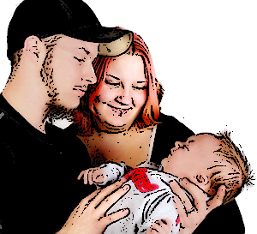
16
What do models and natural growth do differently?
Hint - Virtually everything people create successfully requires it!
What signs or signals help you read the systems around you? How DO systems change from growing old to adapting to new patterns?
The rapid growth of a lasting new relationship is exciting but ends in confirming it is worth perfecting
It’s the same for the birth of a child nature’s recognition that the fully formed but very undeveloped new life is worth perfecting.
So for perfecting human development should we just start spending on caring for what we have?
Think of the center as an inside world connecting with its outside world

Slide 17
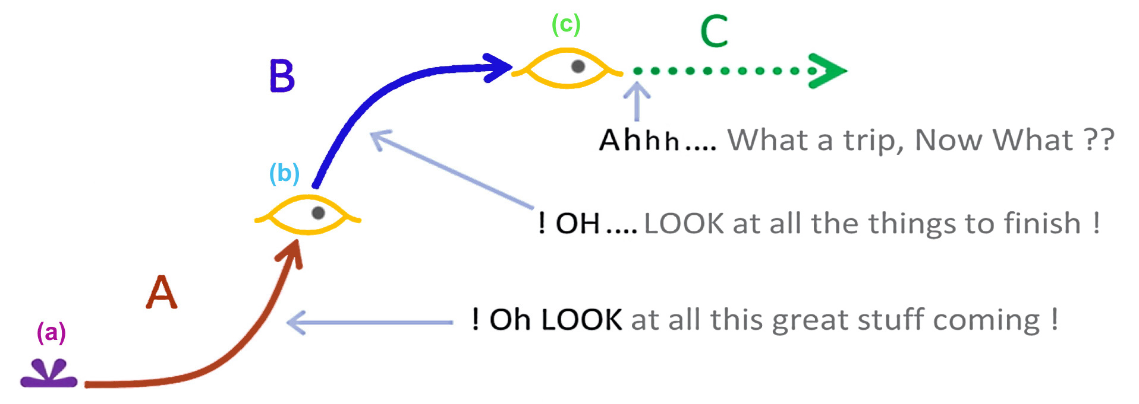
17
A simple curve points to where its ALL happening!
Nature’s Integral
A germ (a), followed by formation A, its turn (b), for development B, seeking perfection (c), and release for engagement C toward reaching its full potential.
an Inside-World connecting with its Outside-Worlds
Formation – Development – Engagement
Germ – Turn – Release
― Growth as an exploratory process of emergence & adaptation ―

Slide 18
HDS New Science for Natural Systems
18
Added Topics
Forces and Guiding of world change 4 slides
Noticing and Steering systems demo 4 slides
Workshop exploration 3 slides
What makes and keeps systems whole 8 slides
Properties and behaviors of whole systems -
System self-governance and steering -
System stability and adaptability -
System transformations -
Language as our first systems science -
Hestian culture as our model for home -
Concepts, Contexts: Blinders to reality -
For # 5 to 11 see the paper - https://synapse9.com/_ISSS-22/
Jessie Henshaw Natural Systems Design Science

Slide 19
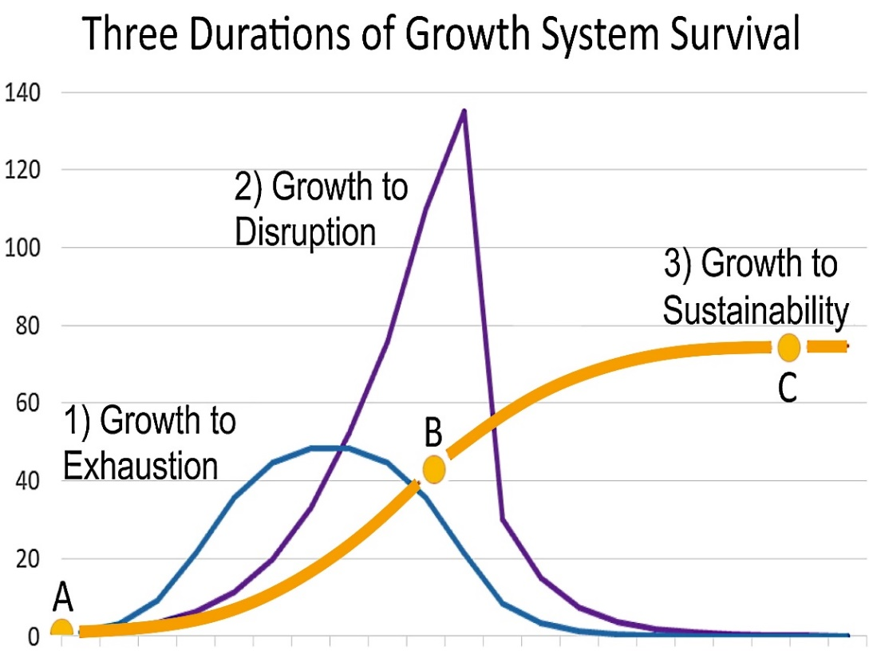
1-Forces and directions of world change
19
Growth’s three types of paths and outcomes
We generate systems of all three kinds
― In our own lives, we almost always choose type three ―
Guided by: sensing and responding to signals flowing through the organizational connections that make systems whole.
Growth ALWAYS triggers a whole system change in internal or external relationships
There are three main types 1) failing to find new resources, 2) failing to limit the exploding demands of growth, 3) to using to care for what growth built.
Today our internal and external crises are multiplying, as a type 2) system.
Most threatening are the system congestion, dissention, and confusion.

Slide 20
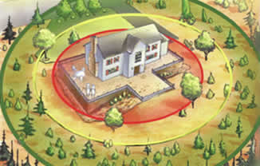
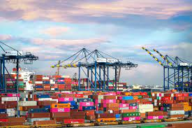
1-Forces and directions of world change
20
People aware of their contexts react, others not
― So, what is there to learn about? ―
We could adjust our rules to estimate profits to the whole
Environments felt and experienced
?
Homes are sensitive to what’s changing all around them, local neighborhoods too, and businesses to change in their industries, so they all adapt to each other.
The financial decisions that steer how the economy develops are generally based on financial models for system remote control, actually held completely harmless in defining sustainability. https://tinyurl.com/yc745be8
These are deeply embedded cultures, so unless the error of elite managers spreads, and wounds their pride, is a whole system change likely.
Unfelt worlds, remote controlled?

Slide 21
1-Forces and directions of world change
21
Lots of forces are moving to care for the needs
we just need to expertly take them much further
― Part of what’s holding them back how to define the problem ―
while we seek limitless power blinds everyone to it causing the growing world crises.
Moving resources from growth going to the care of what growth built is how natural systems do it.
The system still needs profits for resilience to shocks and making collective choices about needs.
Sustainability and Impact Investing already do that, but neither would change the system.
So it’s really necessary for the elite managers to feel the threat to themselves and every one else.

Slide 22
2-Noticing and responding to systems
22
We respond to and steer systems all the time.
― Sometimes from outsides, Mostly from insides. ―
Relationships of all kinds take very careful attention, foresight and hindsight, mostly non-verbal gestures.
An artist, designer or creative team doing their work, shapes their vision of the whole, starting from a inspiring notion, follow it to the end.
A cook collects ingredients, laying out the main parts, adjusting the plan, then moves to the fine parts, arrangements and serving the perfect meal.

Slide 23
2-Noticing and responding to systems
23
How to use data to explore the complex system world
…
The Environmental View
Look at the data then the environments reflected
Ask what’s changing and where its going – stories of:
Places, Cultures, Current events, Short and Long term
The Process View
Think of what’s emerging and how the stages are expressed
The egg, nest, world stages, - ,
Easy, Rough – Inside inspirations & Outside pressures
New relationships discovered

Slide 24
2-Noticing and responding to systems
24
Research strategy for exploring the complex system world
A short list
Initial ideas – all the many functionally coordinating dualities
All the things nature can do with gravity, land, and water
The individual environ system & internal-external partnerships / yin & yang
Complex relations inside and out, w/ a history of - characterize
What holds them together
Design
Distributed Ledgers
A simple model, as a life story arc of developing relationships
Internal and external system evolution
The many arcs of pinnacle long success - Both long prosperity And service
The other arcs – not finding the long grouve
To be sure of observations make sure one’s question lead to new information
The learning new information each time you ask a ‘settled’ question

Slide 25
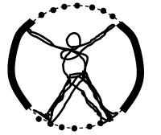
3-Workshop questions
25
A Natural Systems Workshop is an Exploration
Systems generally have many kinds of internal and external relationships
Have many pathways of internal and external communication
Go through many transformations during their lives
So, before one can understand any feature, structure, or event, it takes looking at them from all sides
Column 1 | Column 2
Make notes while listening to others for what else to ask and bring up

Slide 26
3-Workshop questions
26
Q1. But, How do we notice what is brand new ?
What told you it was not just new to you, and what else followed from it
Think about what else might have come before
What might you not see that will come after?
How many can we name, and say something interesting?
A new friend smiled | I didn’t get a call last week
No one is responding | My partner was so angry
My friend needs help | I smell something, I hear something
Make notes while listening to others for what else to ask and bring up

Slide 27
3-Workshop questions
27
Q2. Our world is changing, but how and why?
Relationships, Politics? Family and friends
Longer changes: The Climate? The Societies?
Our relation to nature? Our relations between societies?
An ever faster expanding and more demanding economy?
How many can we name, and say something interesting?
What were things like Before? −− What will they be like After? | What will they be like After ?
Think of changes you could describe First explore the timeline of a variety of small changes | Do one in as much detail as you can Then explore longer term ones you have data or contacts to consult on
Make notes while listening to others for what else to ask and bring up

Slide 28
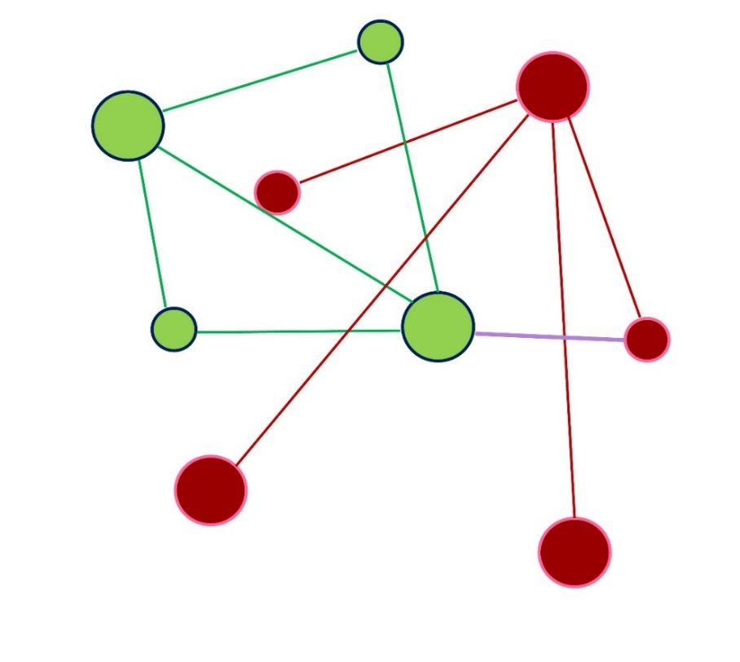
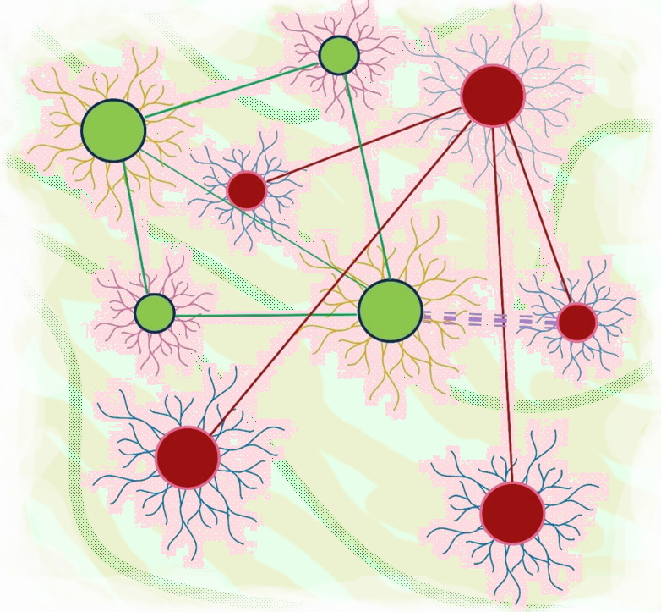
3-What keeps systems whole
28
Homes makes things whole
Integrated with contexts and private centers “with connection”
Links alone are abstract and without contexts and the relationships
That create giving meaning to and energizing each whole
Conceptual Network
of just the connections
Natural Systems of hubs w/ hives inside in context
Abstract concepts without context v. Sustaining homes providing meaning

Slide 29
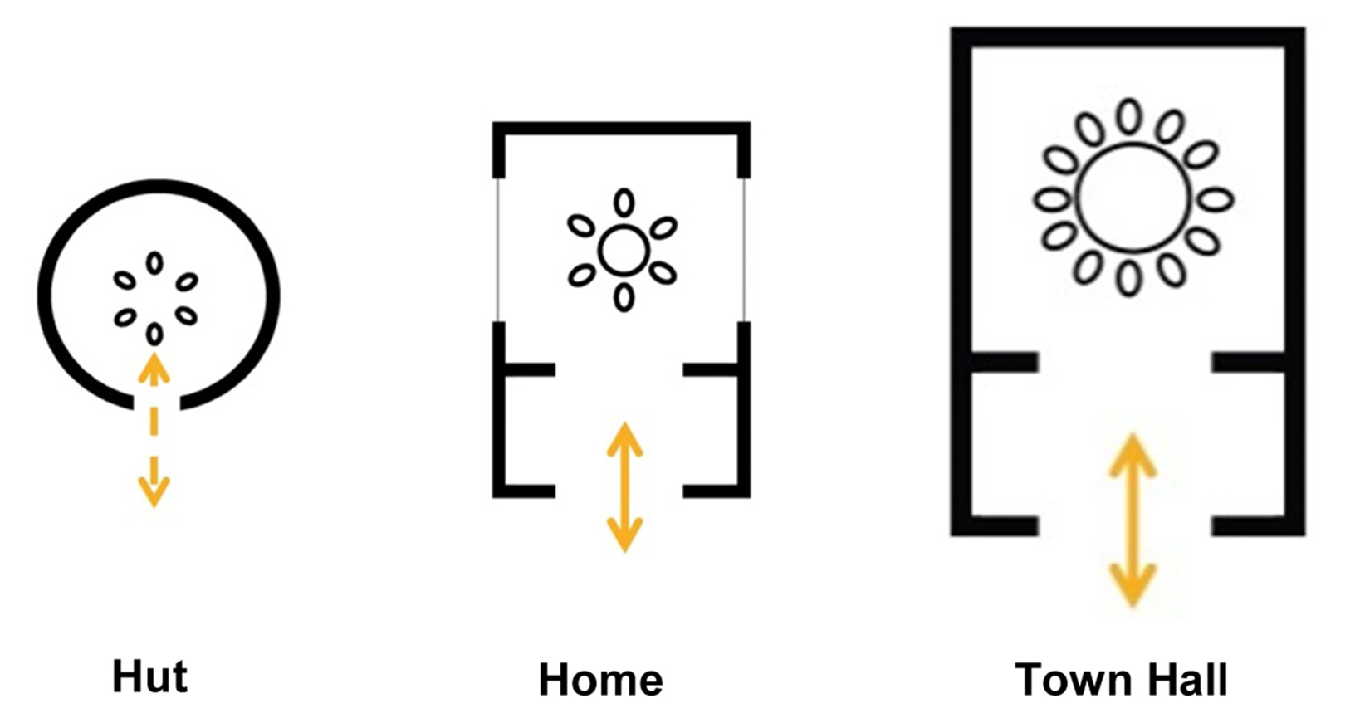
3-What keeps systems whole
29
The Basic Shapes of Homes
Centers with connection: the design of nature
Internal cultures with access to external needs
Each center – intimate connection inside, push & pull and collaborative relationships outside.
The gates regulate contact with collaborative, threatening, and push & pull connection
Guided by individuals reading signals from their worlds

Slide 30
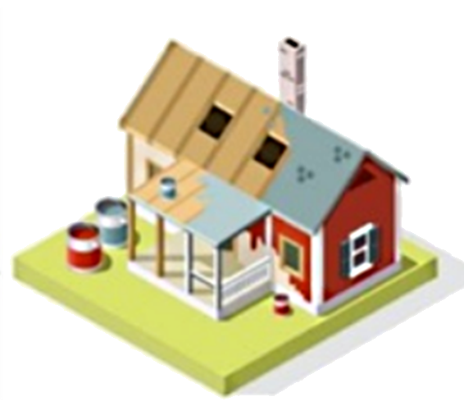
3-What keeps systems whole
30
Human design builds things whole
How did we learn to so skillfully replicate it?
And then SO TOTALLY neglect it?
In designing our use of the earth?
Each stage linking with the last to serve and enable the next
– inspired buy the buyer, to fit family needs, a plan developed by the architect and builder, coordinated with the site, neighbors, and county,
– site work, foundations, framing, utilities, enclosure, interiors, finishes, landscape, furnishing, and move in.
People so often start with visions of a whole and fashion parts to make the work whole.
Where did we get the Un-wholly Frankenstein idea of endlessly multiplying wholes? Was it our conceptual thinking, detached from its contexts?
Guided by perfection: a natural self-limiting teleology of design

Slide 31
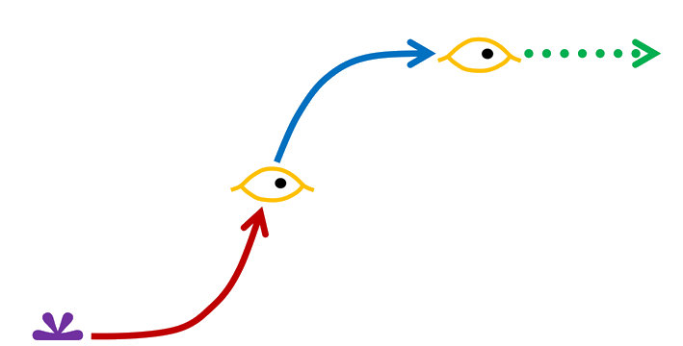
3-What keeps systems whole
31
Natural design builds things whole
Growth is accumulative design, adapting replications of the initial seed pattern to remain whole – biological cell, energy process, organization spark, first crystal
Development is from simple to complex, an exploratory process of fitting parts for their emergent properties, making frameworks to fill in and perfect.
A successful growth the path is one of increasing scale and organization for new environments – then limiting scale and adaptation for a climax environment.
The main pattern is the “egg-nest-world” – living systems & cultures, technologies & religions, all held together by the emergent properties of their designs
Guided by perfection: a natural self-limiting teleology of design

Slide 32
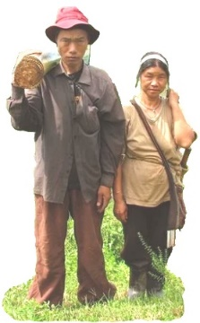
3-What keeps systems whole
32
Tensegrity of push and pull with emergent properties
rigid and flexible for mobility, polycentric for mutuality,
Masts and sails
Personal relationships
dance,
war, traffic,
aligned wheels,
Families & communities
Guided by versatile capabilities navigating environments

Slide 33
3-What keeps systems whole
33
Distributed “common ledgers” for making things whole
Shared Maps of Living System Designs
Common Language – every speaker inherits an authentic copy of its roots and usage – requiring – users to recognize each other’s meanings, coordinate new meanings which may or may not last, maintain root meanings – a very long-lived flexible structure
Common Cultures – Including native, racial, societal, regional, community, family, business, professional, generational, religious, social, etc. – range of very and less reproduceable, includes ways of knowing and living, the origin of incommunicative “silos” unable to understand each other – maintained by much the same peer to peer “recognition” and “coordination” bonding of members as common languages.
Providing BOTH reproductive integrity & coordinated development

Slide 34
3-What keeps systems whole
34
2. Distributed “common ledgers” for make things whole
Shared codes of living system design
Common Genetic codes – a distributed systems design map in each cell – faithfully replicated except when accidental or opportunistic changes are kept rather than corrected – anchoring the most persistent inherited root ways of working – evidently capable of progressive whole system change for punctuated species change.
Common Legal & Economic codes – Distributed standards of cooperation and working – inherited and evolved from founding inspirations – actively validated and coordinated in responding to new experience – transformative when the opportunity presents.
=> Evolutionary Governance allowing whole system transformation when an innovation elicits a coordinated whole system response like a need for “survival” first requiring growth, then requiring versatile perfected design and stability.
Providing BOTH reproductive integrity & coordinated development

Slide 35
New Science for Natural Systems
Resource Links, Additional Topics Below
ISSS 2022 Slide Sets and Paper https://synapse9.com/_ISSS-22
Contact & Research https://synapse9.com/signals/
Jessie Henshaw Natural Systems Design Science
Notes:
Figure credits – Noticing systems
–date
credit
y/n
what
Link +
2022 06-05
n
Wet sidewalk
https://legalnewsline.com/stories/539126473-rainy-sidewalk-a-dangerous-condition-ark-court-rules-630k-verdict-the-result-of-trial-by-ambush
2022 06-05
– Credit: Photo by Pat Krupa on Unsplash
y
42nd St rain
https://unsplash.com/photos/2WSVjnvIQDs
2022 06-05
Credit: Lawnpro
y
Mushroom –
https://www.absolutelawnpros.com/why-are-mushrooms-growing-in-my-lawn/
2022 06-05
Credit: Joaquim Campa @JoaquimCampa
y
Nature interrupted-bear & photogs
https://twitter.com/JoaquimCampa/status/1350843591040659458/photo/1
2022 06-05
Credit: Kidspot.co.nz
y
Baby face
https://kidspot.co.nz/baby/kids-health-sticky-eye/
2022 06-05
Image Credit - Discover Richmond Tours
y
View of Richmond
https://discoverrichmondtours.com/best-views-overlooks-richmond-va/
2022 06-06
Credit: LinkedIn Learning Blog
NewSuccess
https://www.linkedin.com/business/learning/blog/career-success-tips

Slide 36
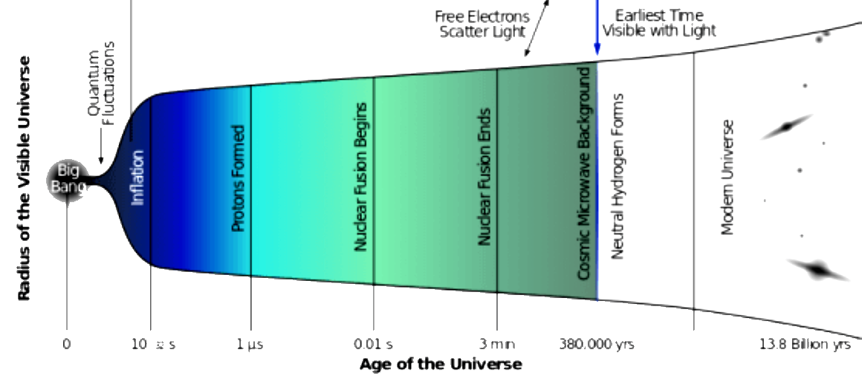
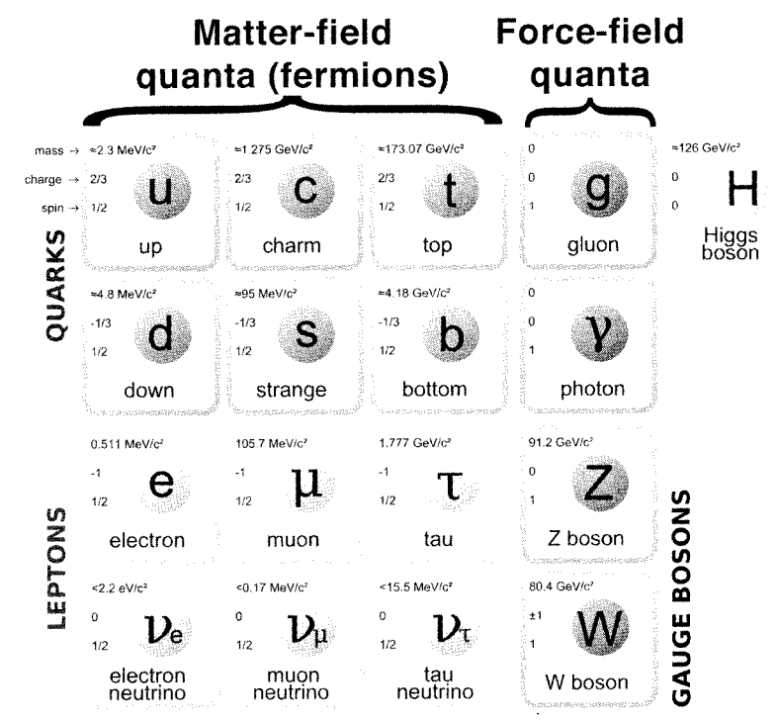
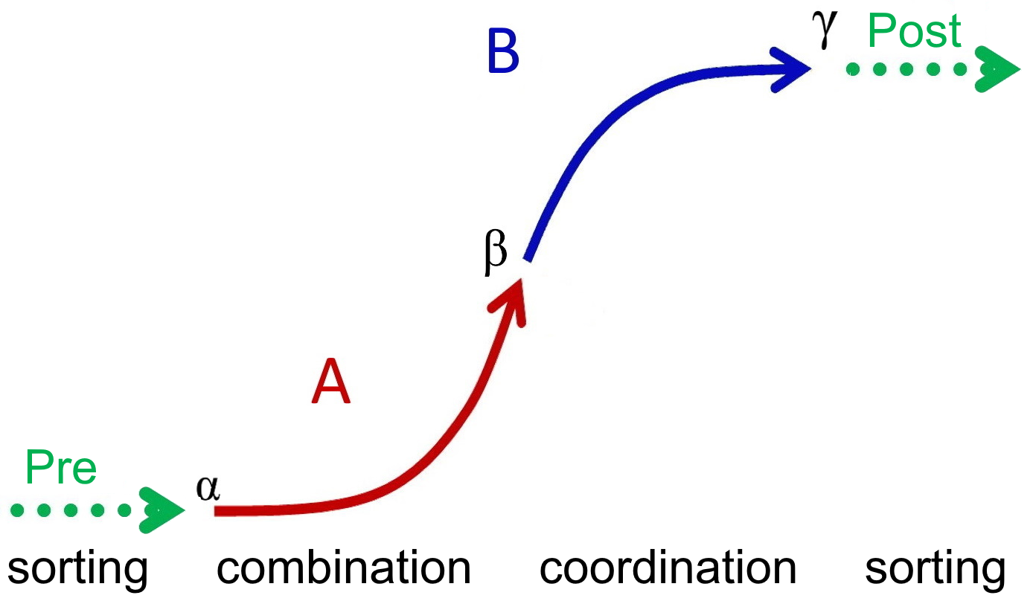
36
Are there transformations in the formation of the universe?
Organizational Scales of the Universe ?
Standard Model of Elemental Quanta
Space
The 17 Quanta
Protons and Neutrons
Atomic nuclei
Atoms
Stars
Galaxies
Standard Model of Elemental Quanta
Standard Emergent Transformation

Slide 37
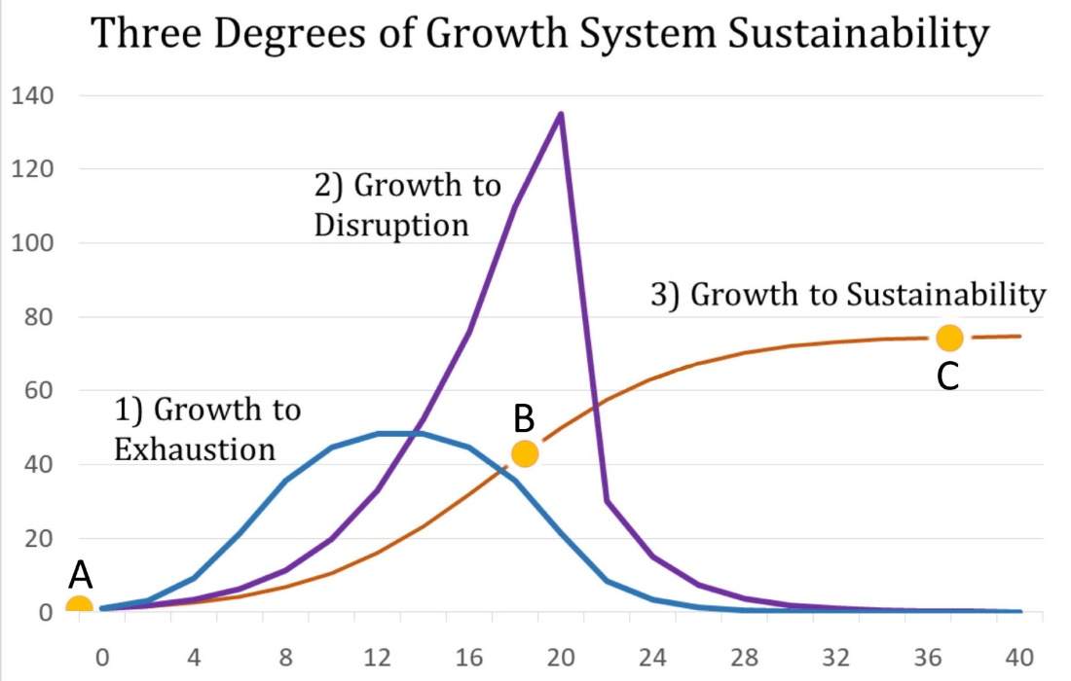
37
Rather than as embedded in living environments
HDS New science for Individual Systems
A path to the future where things can go wrong
Guided by: sensing and responding to environmental signals

Slide 38
38
Rather than as embedded in living environments
HDS New science for Individual Systems
Homes
Each center has zero degrees of separation inside, with push & pull and collaborative relationships outside.
The gates regulate contact with collaborative, threatening, and push & pull connection
Guided by individuals reading signals, responding to a world

Slide 39
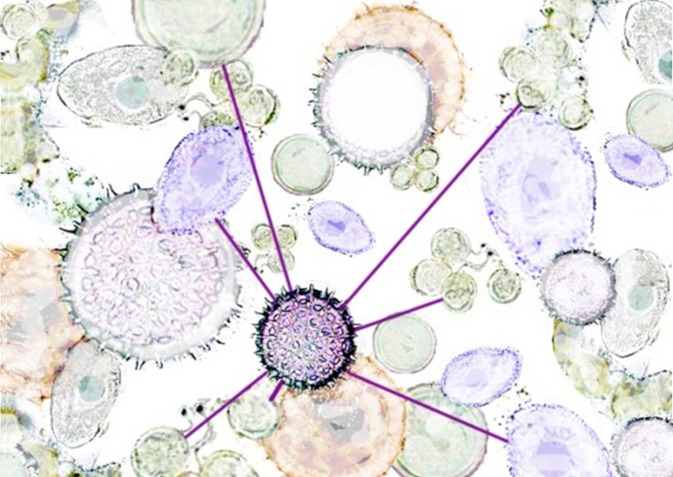
39
Rather than as embedded in living environments
The Shapes Tearing Things Apart
Homes to lively centers, exploring push and pull relationships
Emissions From Tropical Megacities Could Usher in ‘New Era of Air Pollution’
What happens when Covid Becomes Endemic
Ex-Banker Convicted in the Looting of Malaysia
Globalized crises - breaking out everywhere
The Top 100 World Crises Growing With Growth (100CrisesTable.pdf)
Guided by fruitful whole system relationships

Slide 40
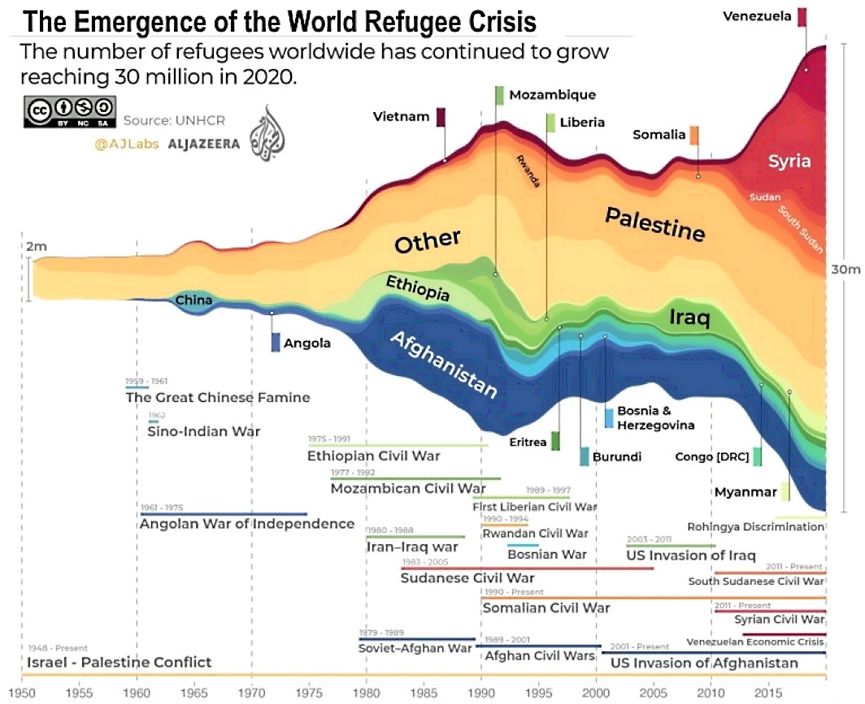
40
Rather than as embedded in living environments
World Developing Refugee Crisis or Crises?
NY Times, on Apr 9, 2022
Emissions From Tropical Megacities Could Usher in ‘New Era of Air Pollution’
What happens when Covid Becomes Endemic
Ex-Banker Convicted in the Looting of Malaysia
Globalized crises - breaking out everywhere
The Top 100 World Crises Growing With Growth (100CrisesTable.pdf)
From Rising Pressures, Leaving no Space for Independence

Slide 41
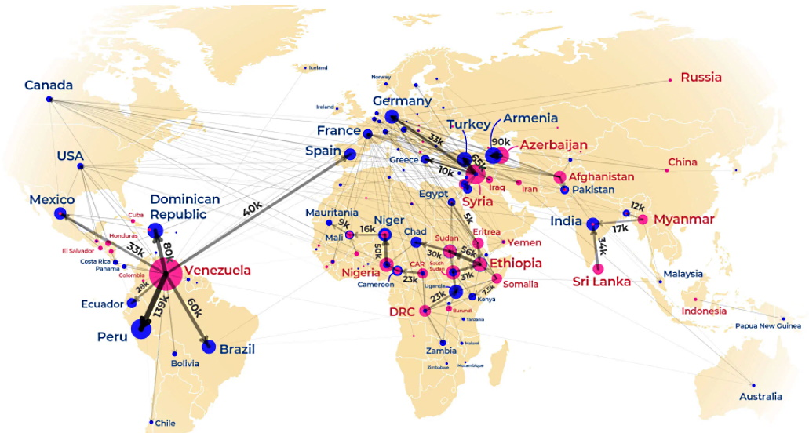
41
Rather than as embedded in living environments
Locations of Developing Refugee Crisis or Crises
NY Times, on Apr 9, 2022
Emissions From Tropical Megacities Could Usher in ‘New Era of Air Pollution’
What happens when Covid Becomes Endemic
Ex-Banker Convicted in the Looting of Malaysia
Globalized crises - breaking out everywhere
The Top 100 World Crises Growing With Growth (100CrisesTable.pdf)
From Rising Pressures, Leaving no Space for Independence

Slide 42
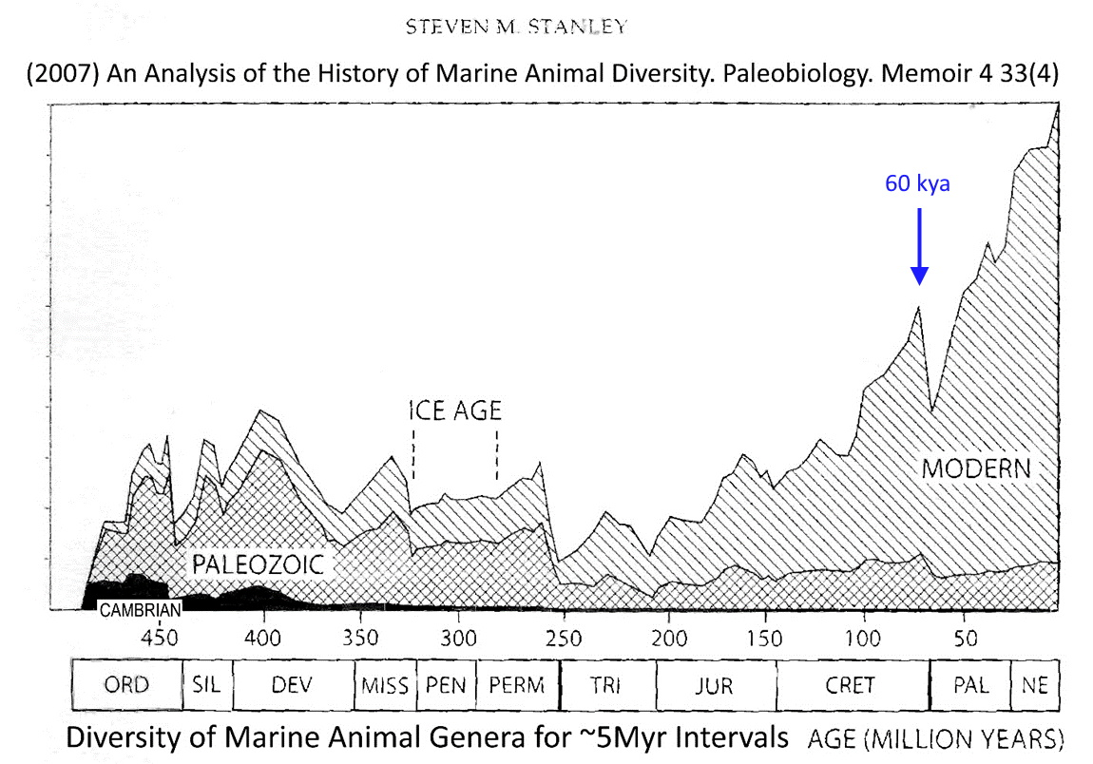
42
Rather than as embedded in living environments
Developing Diversity of Marine Life?
NY Times, on Apr 9, 2022
Emissions From Tropical Megacities Could Usher in ‘New Era of Air Pollution’
What happens when Covid Becomes Endemic
Ex-Banker Convicted in the Looting of Malaysia
Globalized crises - breaking out everywhere
The Top 100 World Crises Growing With Growth (100CrisesTable.pdf)
From Rising Pressures, Leaving no Space for Independence

Slide 43
43
Holistic Natural Systems, Design & Steering
sy@synapse9.com http://synapse9.com/signals
Jessie Henshaw Natural Systems Design Science

Slide 44
HDS New science for Individual Systems
Natural growth designs things whole
Growth is accumulative design, adapting replications of the initial seed pattern to remain whole – biological cell, energy process, organization spark, first crystal
Development is from simple to complex, an exploratory process of fitting parts for their emergent properties, making frameworks to fill in and perfect.
A successful growth the path is one of increasing scale and organization for new environments – then limiting scale and adaptation for a climax environment.
The main pattern is the “egg-nest-world” – living systems & cultures, technologies & religions, all held together by the emergent properties of their designs
Guided by perfection: an implicit teleology of design?

Slide 45
HDS New science for Individual Systems
The Shapes Holding Things Together
Homes as lively centers, connecting with push and pull relationships seeking integrity
Exploration and the stabilization of reliable roles
Emerging local and whole system designs as innovations develop, mature and find their roles.
Development guided by the implicit teleology of perfecting designs
Exploratory Connection Leaving Space for Independence

Slide 46
HDS New science for Individual Systems
Homes – the Basic System Design Holding things Together
Each center – intimate connection inside, push & pull and collaborative relationships outside.
The gates regulate contact with collaborative, threatening, and push & pull connection
Guided by individuals reading signals from their worlds

Slide 47
HDS New science for Individual Systems
What makes wholes whole? To “hold” together?
Growth from immature, to fledgling then perfected design
In its “egg,” to “nest,” to “world” environments
Things people make whole start with a vision of wholeness, then fitting parts together until it’s Complete.
Things nature makes whole start a small germ of design, building scale and refining organization toward perfect harmony.
Guided by perfection: an implicit teleology of design?

Slide 48
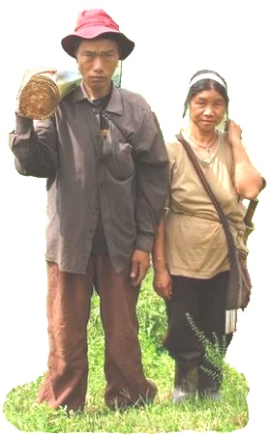
HDS New science for Individual Systems
Push and Pull with emergent properties
Masts and sails –
Personal relationships –
Other examples?
- dance, war, traffic, aligned wheels, homes
.
Guided by versatile capabilities navigating environments

Slide 49
HDS New science for Individual Systems
Shared “common ledgers” make things whole
Universally shared maps of living system designs
Common Language – requiring users to coordinate meanings, retain root meanings and history of development
– anchoring authentic inherited current forms of knowledge
– validated and coordinated in life by finding agreement on meanings
– retaining the root meanings and interpretations that anchor of word use
– assuring that the common understandings are retained.
Shared genetics – Similar distributed ledger for a body’s culture
– A common reference for guiding peer to peer system coordination.
= Reproductive integrity with polycentric design animated and anchored by the pushes and pulls of holistic self-governance

Slide 50
HDS New science for Individual Systems
Shared “common ledgers” make things whole
Universally shared maps of living system designs
Common cultures – Like language, a distributed ledger of how to live
– anchoring authentic inherited root ways of living and knowing
– flexible keys to verbal and non-verbal recognition and collaboration
– actively validated and coordinated in forming relationships
Local cultures – Locally distributed ways of working
– inherited from growth around the founding inspirations
– actively validated and coordinated in responding to new experience.
= Reproductive integrity with polycentric design animated and anchored by the pushes and pulls of holistic self-governance

Slide 51
New Science for Natural Systems Jessie Henshaw
End
ISSS 2022 Slide Sets and Paper https://synapse9.com/_ISSS-22
Contact & Research https://synapse9.com/signals/
Jessie Henshaw Natural Systems Design Science
Notes:
Figure credits – Noticing systems
–date
credit
y/n
what
Link +
2022 06-05
n
Wet sidewalk
https://legalnewsline.com/stories/539126473-rainy-sidewalk-a-dangerous-condition-ark-court-rules-630k-verdict-the-result-of-trial-by-ambush
2022 06-05
– Credit: Photo by Pat Krupa on Unsplash
y
42nd St rain
https://unsplash.com/photos/2WSVjnvIQDs
2022 06-05
Credit: Lawnpro
y
Mushroom –
https://www.absolutelawnpros.com/why-are-mushrooms-growing-in-my-lawn/
2022 06-05
Credit: Joaquim Campa @JoaquimCampa
y
Nature interrupted-bear & photogs
https://twitter.com/JoaquimCampa/status/1350843591040659458/photo/1
2022 06-05
Credit: Kidspot.co.nz
y
Baby face
https://kidspot.co.nz/baby/kids-health-sticky-eye/
2022 06-05
Image Credit - Discover Richmond Tours
y
View of Richmond
https://discoverrichmondtours.com/best-views-overlooks-richmond-va/
2022 06-06
Credit: LinkedIn Learning Blog
NewSuccess
https://www.linkedin.com/business/learning/blog/career-success-tips

