Slide 1
Growth Constant Fingerprints of Economically Driven Climate Change From its origin in 1780 to its major post WWII acceleration:
HDS Whole Systems Thinking – Research paper figures
Figures for the paper and Supplemental Materials.
Key Words: natural systems physics, climate, human fingerprints, economic drivers, self-organization, growth constant states, coupling CO2 & warming
Jessie Henshaw
Paper Fig numbers are Slide Deck page numbers less one

Slide 2
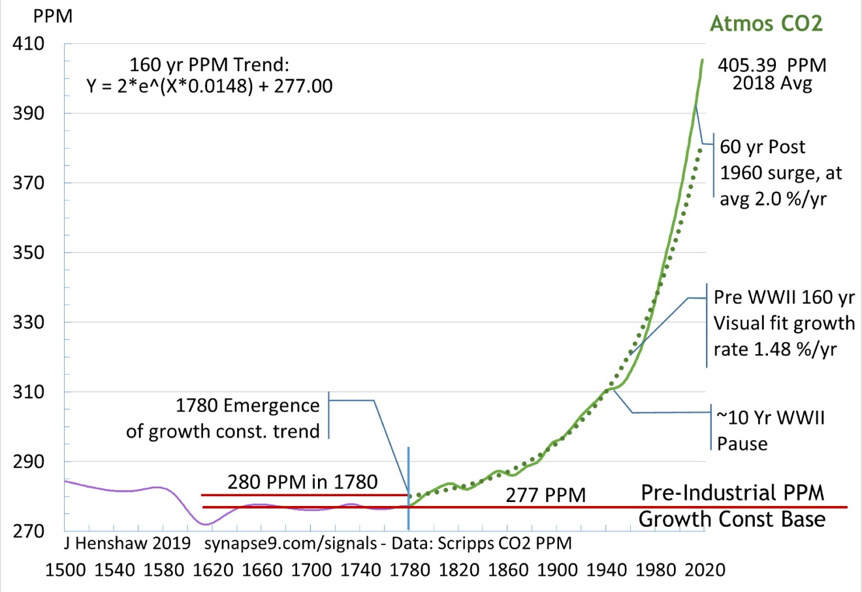
HDS Growth Constants and Warming
Jessie Henshaw
First slide of the Paper - See the paper text

Slide 3
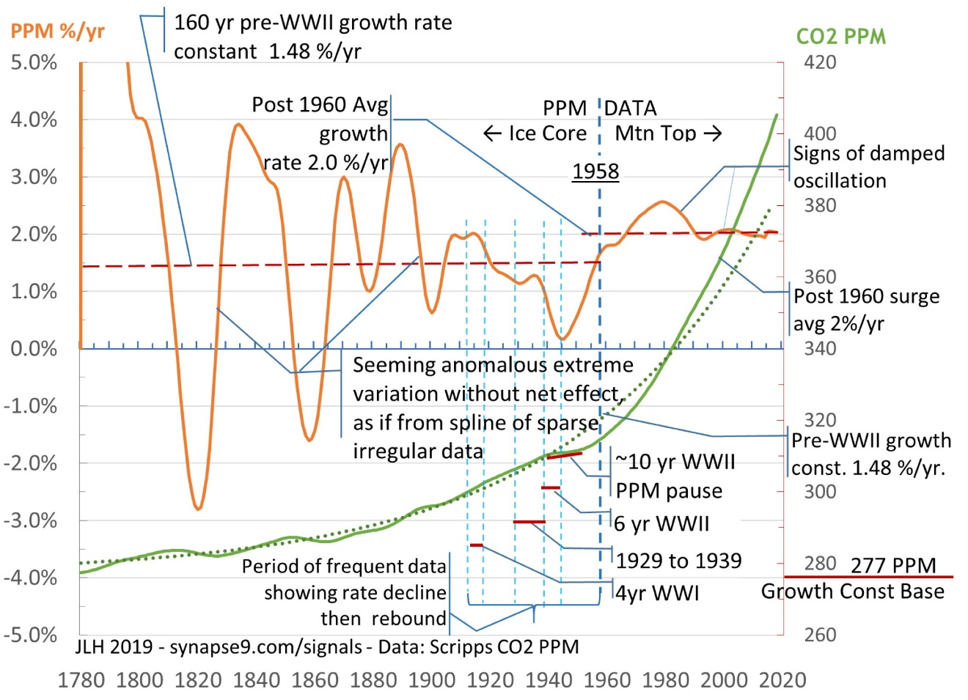
HDS Growth Constants and Warming
Jessie Henshaw

Slide 4
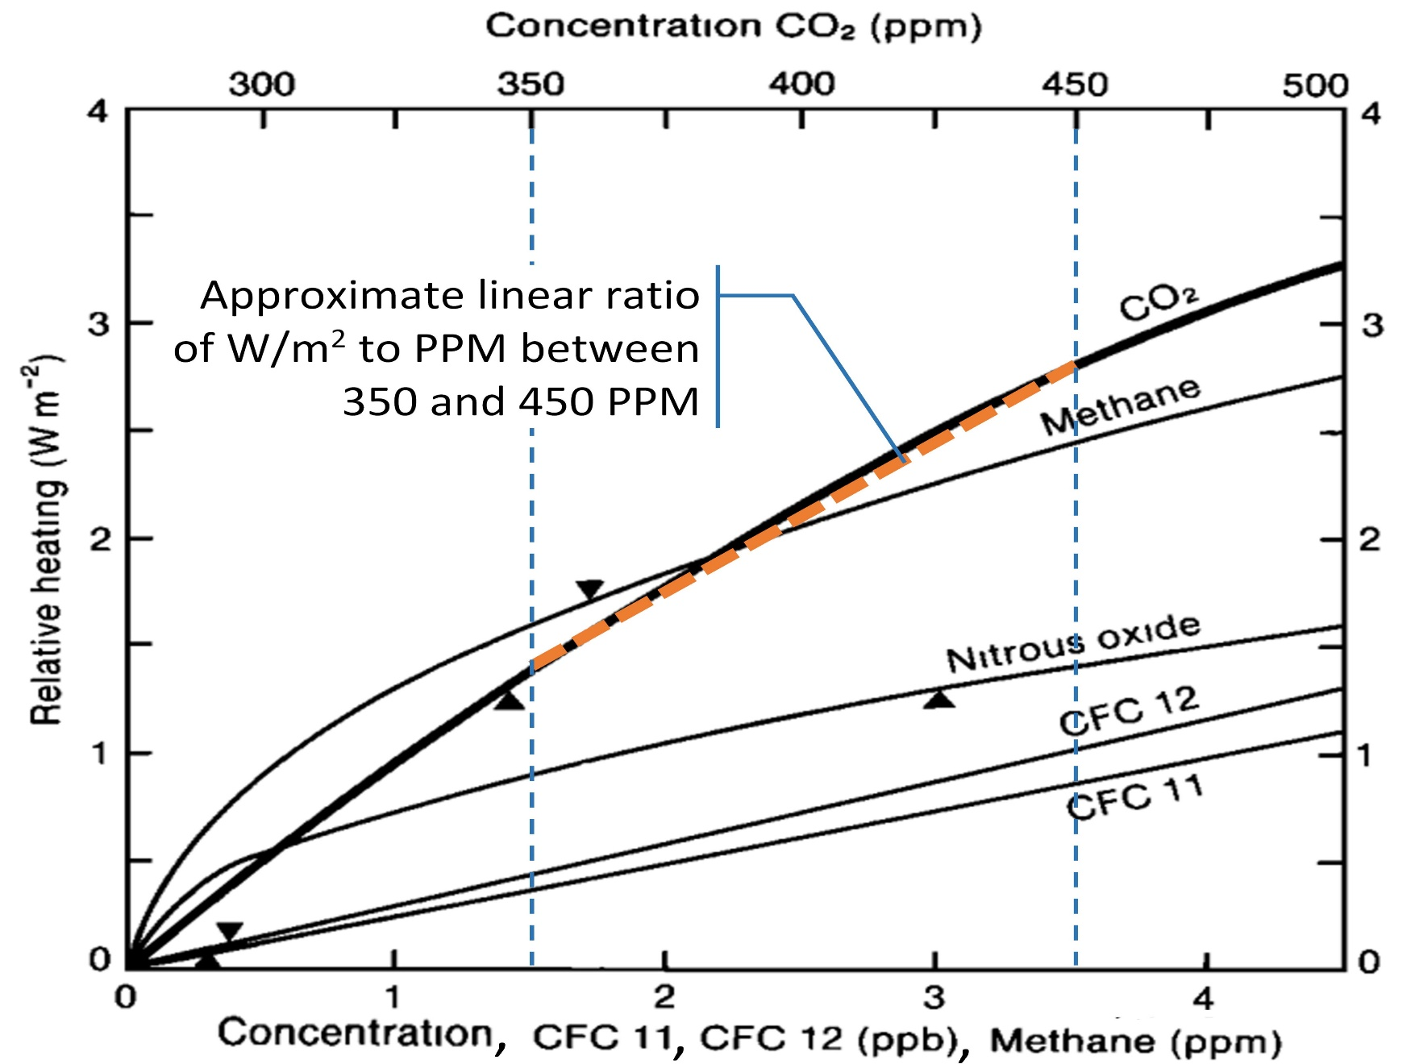
HDS Growth Constants and Warming
Jessie Henshaw

Slide 5
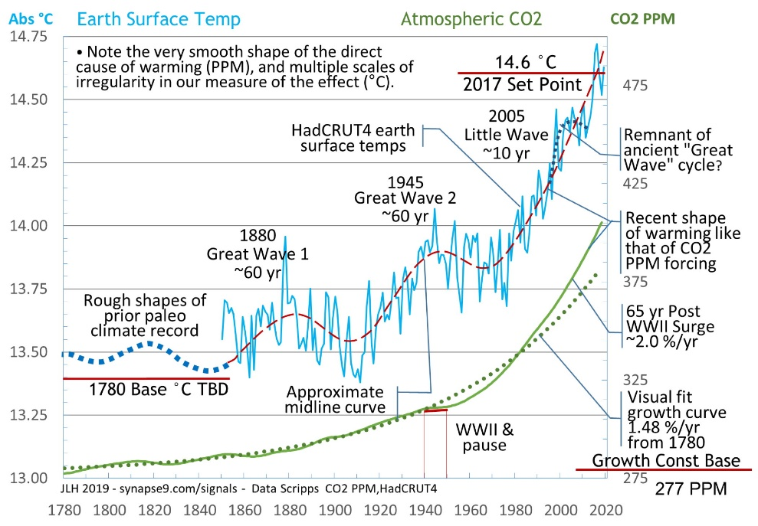
HDS Growth Constants and Warming
Jessie Henshaw

Slide 6
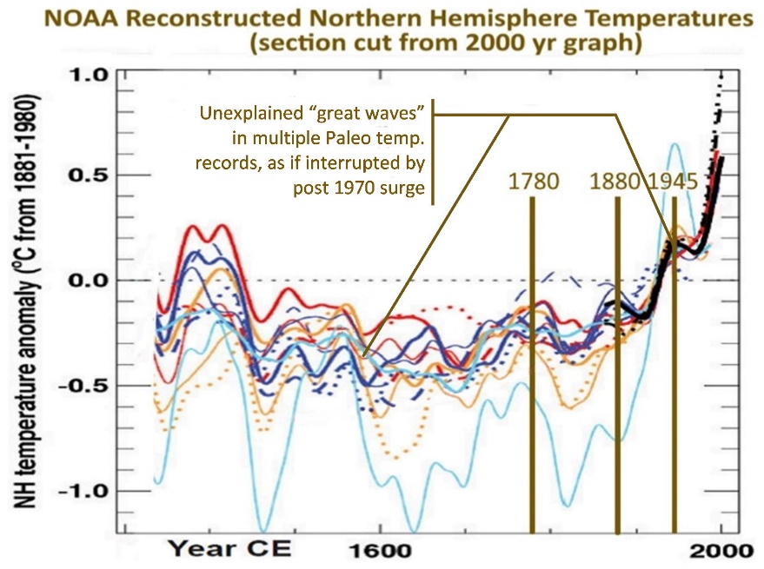
HDS Growth Constants and Warming
Jessie Henshaw

Slide 7
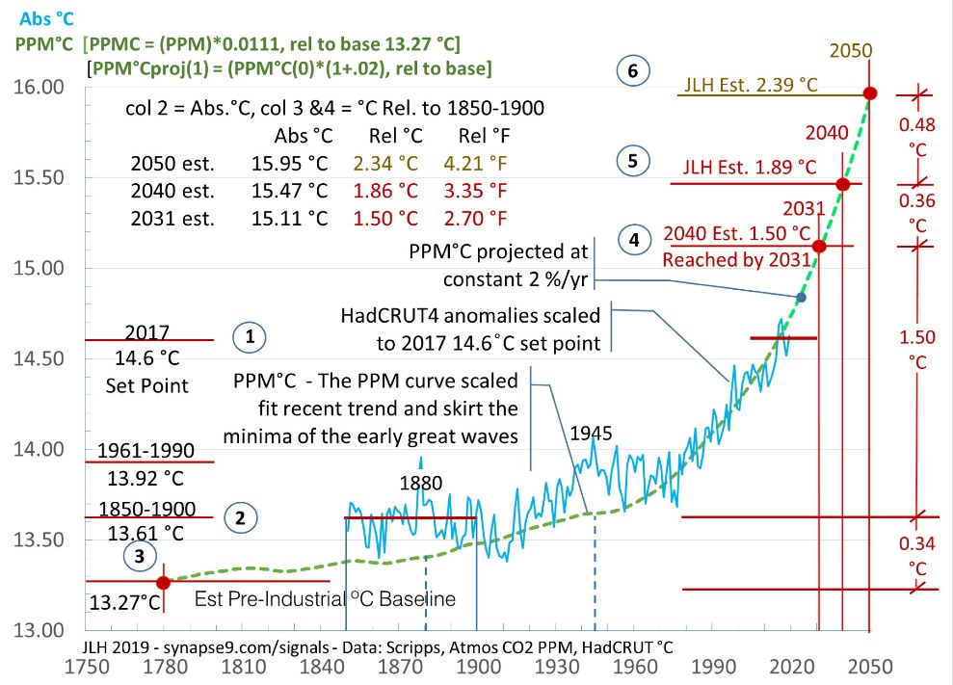
HDS Growth Constants and Warming
Jessie Henshaw

Slide 8
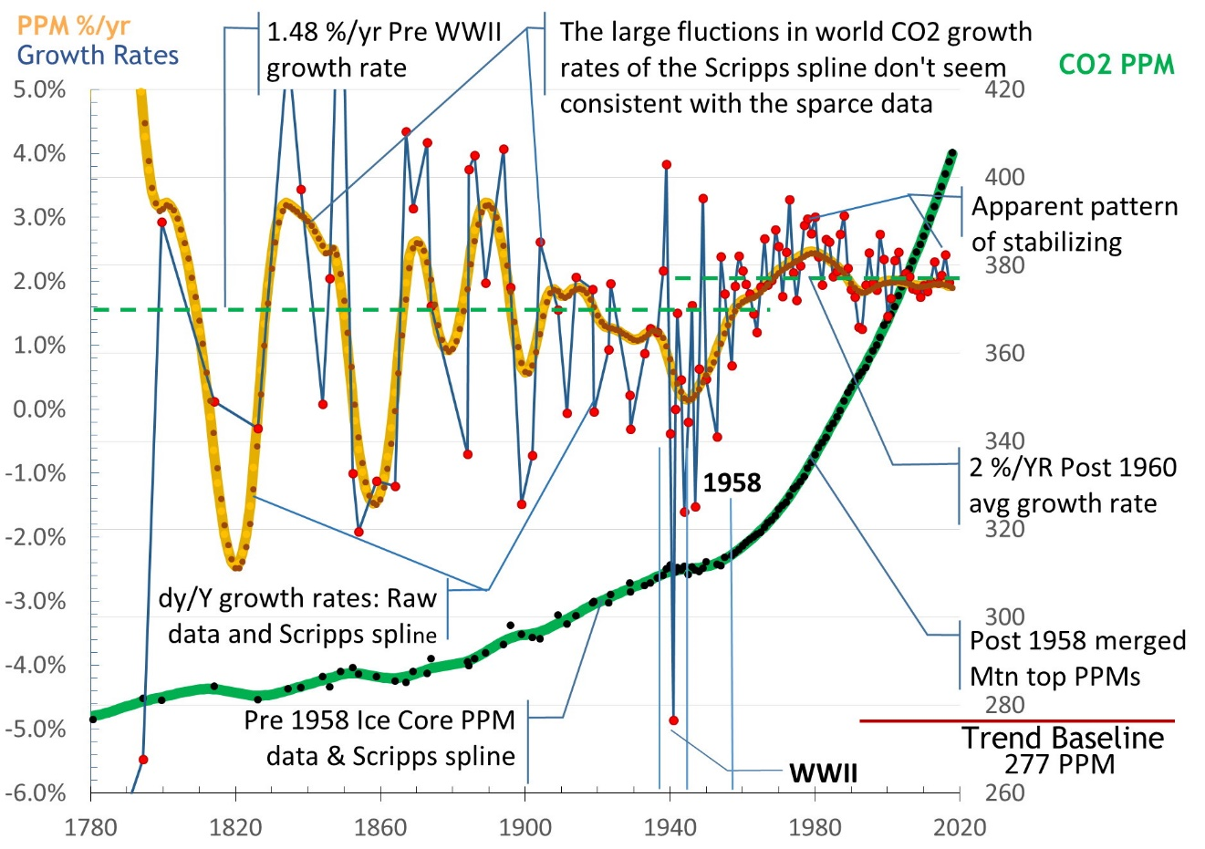
HDS Growth Constants and Warming
Jessie Henshaw
First slide of Supplemental Material – see Supplemental text

Slide 9
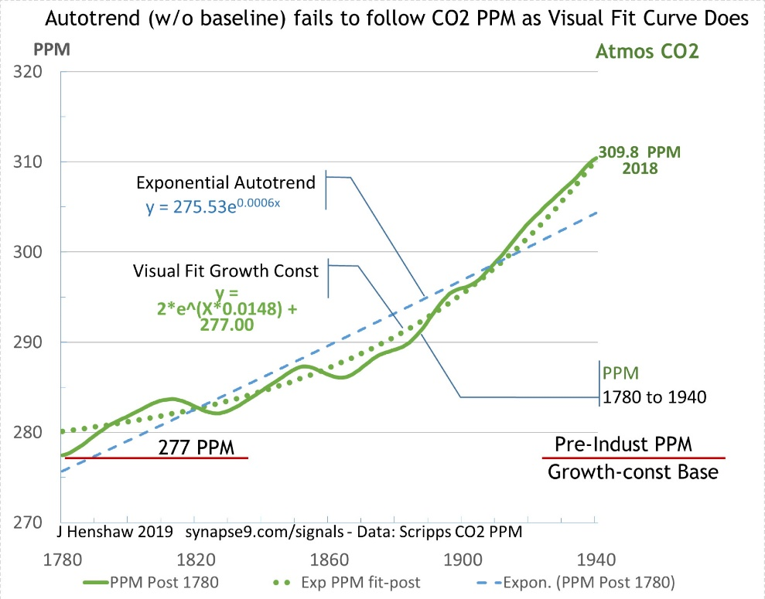
HDS Growth Constants and Warming
Jessie Henshaw

Slide 10
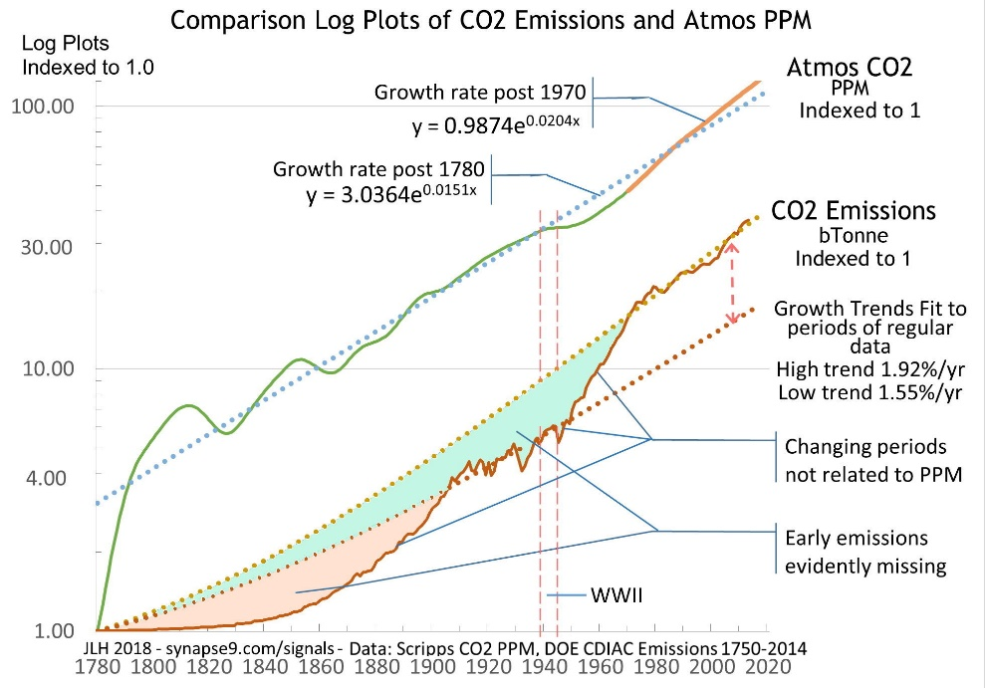
HDS Growth Constants and Warming
Jessie Henshaw

Slide 11
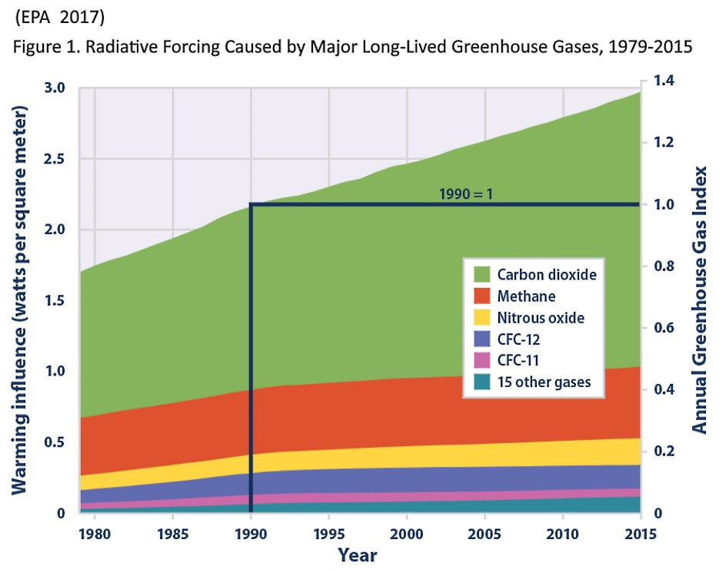
HDS Growth Constants and Warming
Jessie Henshaw

Slide 12
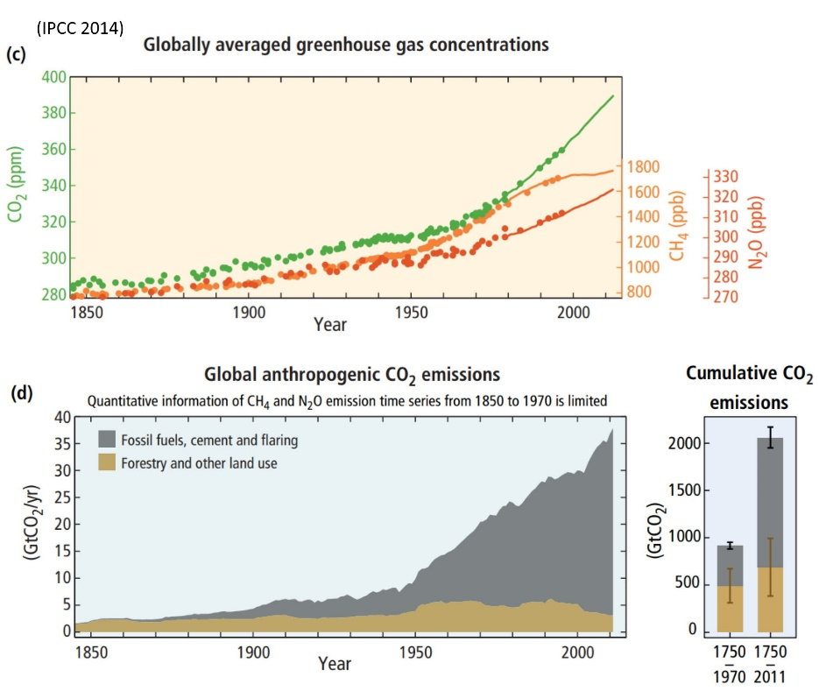
HDS Growth Constants and Warming
Jessie Henshaw

Slide 13
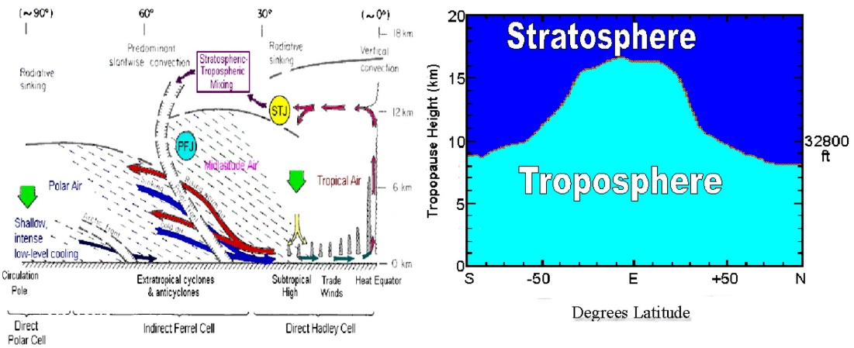
HDS Growth Constants and Warming
Jessie Henshaw

Slide 14
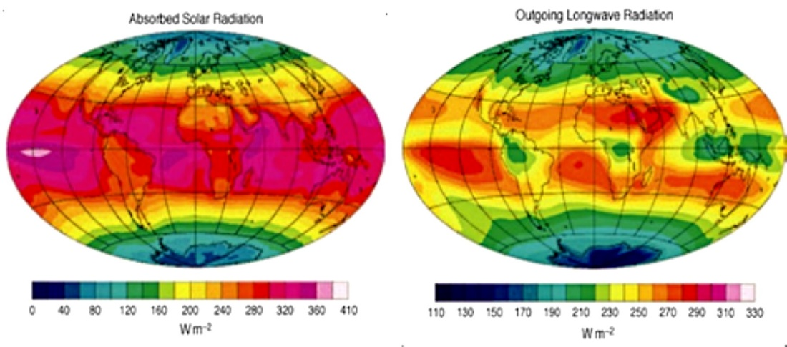
HDS Growth Constants and Warming
Jessie Henshaw

Slide 15
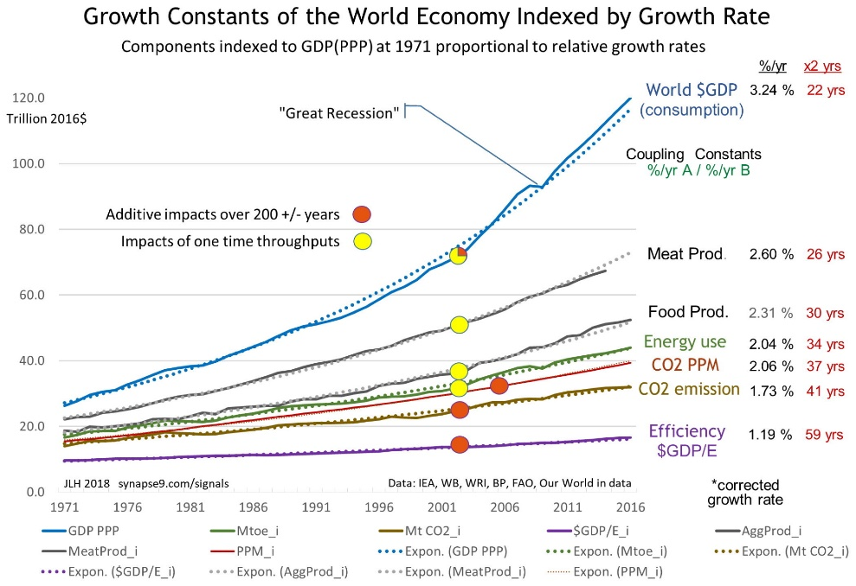
HDS Growth Constants and Warming
Jessie Henshaw

Slide 16
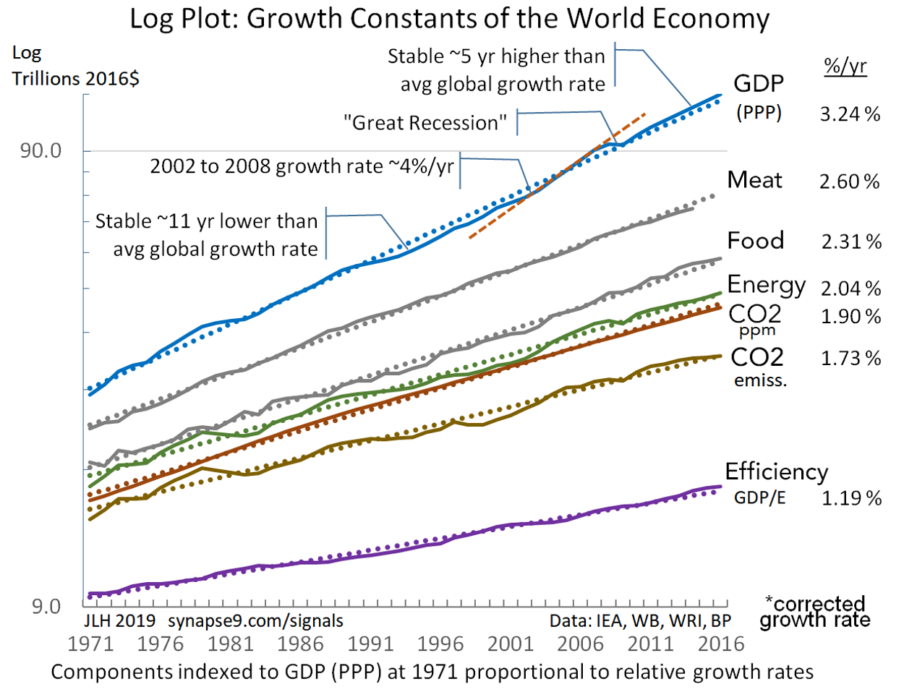
HDS Growth Constants and Warming
Jessie Henshaw

Slide 17
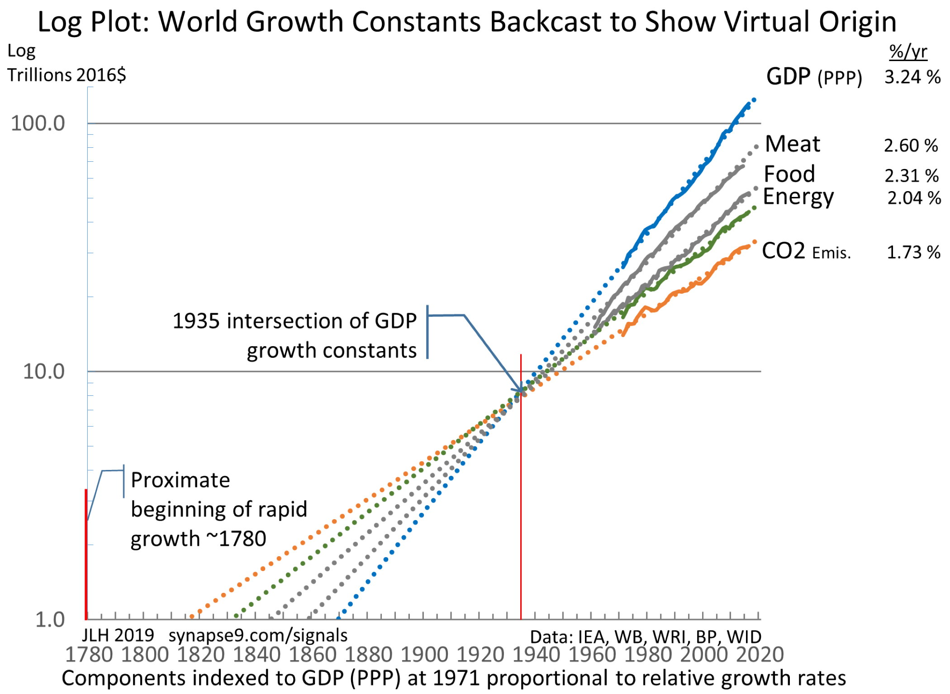
HDS Growth Constants and Warming
Jessie Henshaw

Slide 18
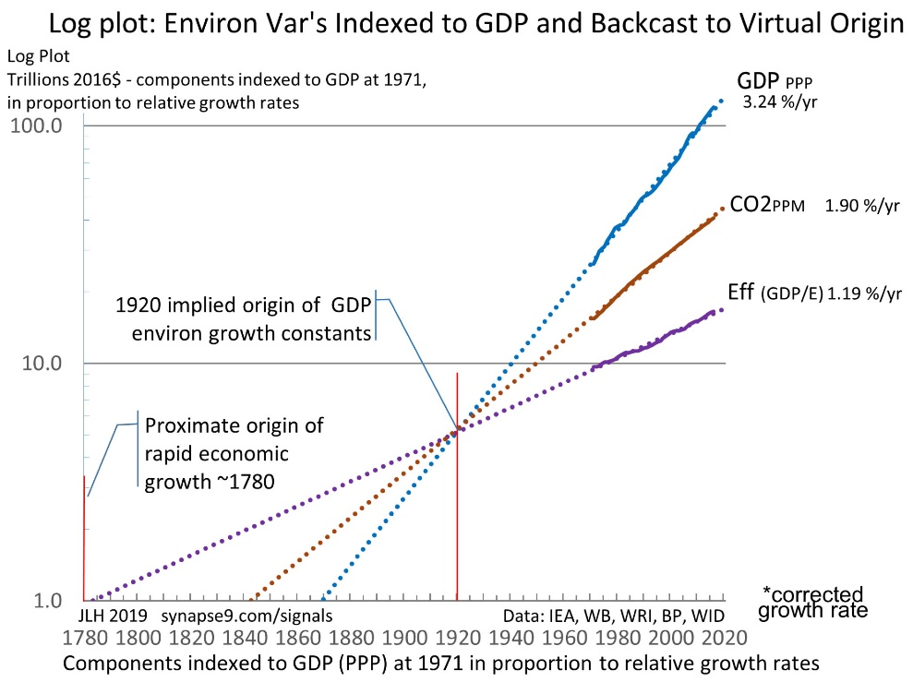
HDS Growth Constants and Warming
Jessie Henshaw

Slide 19
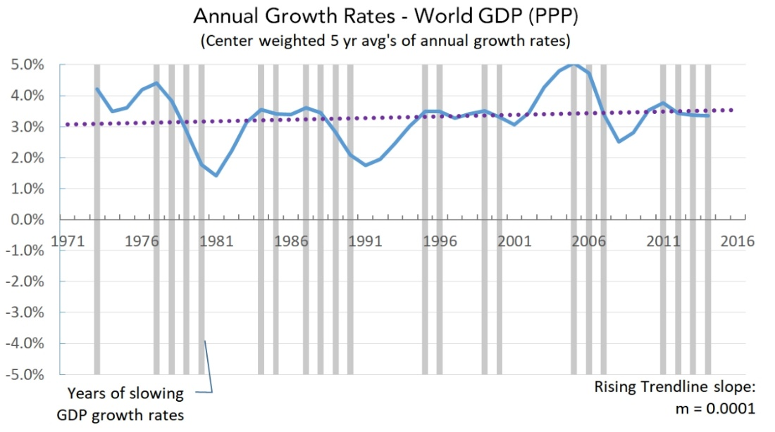
HDS Growth Constants and Warming
Jessie Henshaw

Slide 20
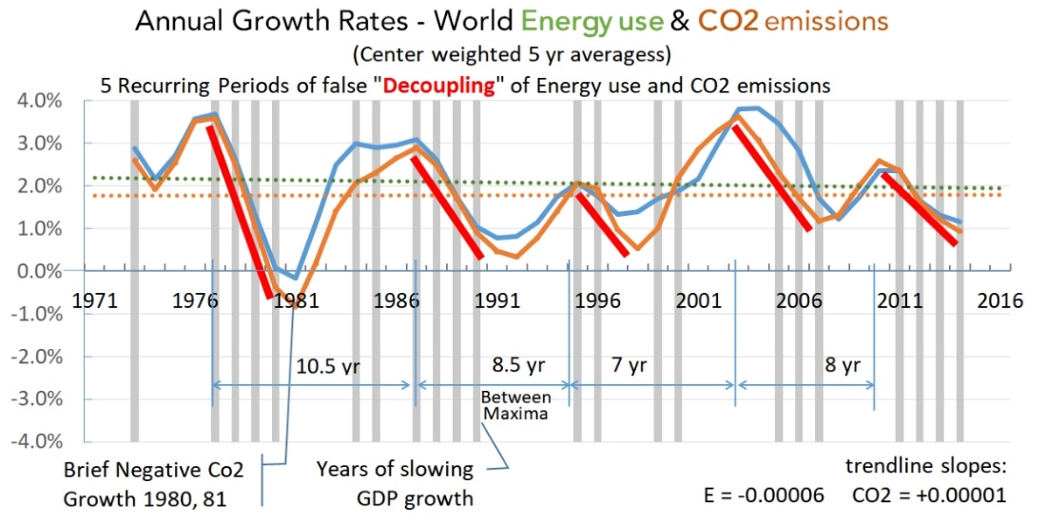
HDS Growth Constants and Warming
Jessie Henshaw

Slide 21
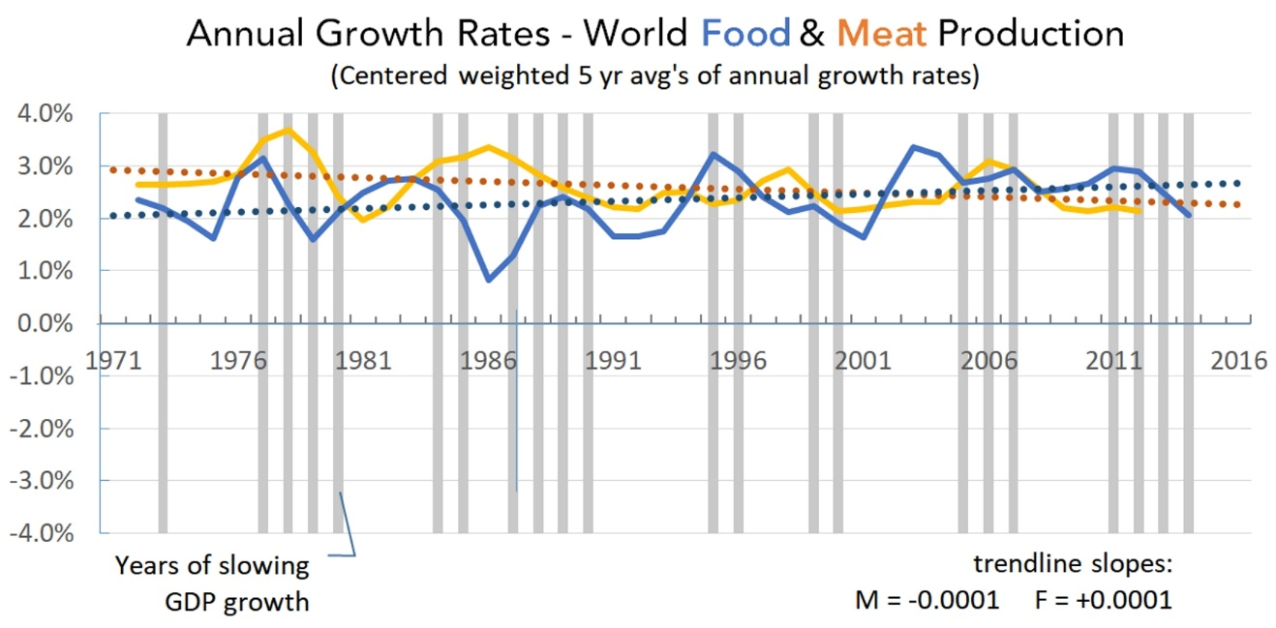
HDS Growth Constants and Warming
Jessie Henshaw

Slide 22
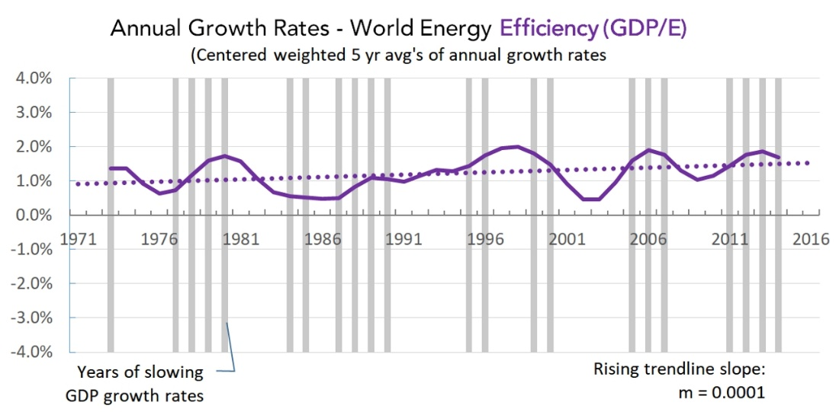
HDS Growth Constants and Warming
Jessie Henshaw

Slide 23
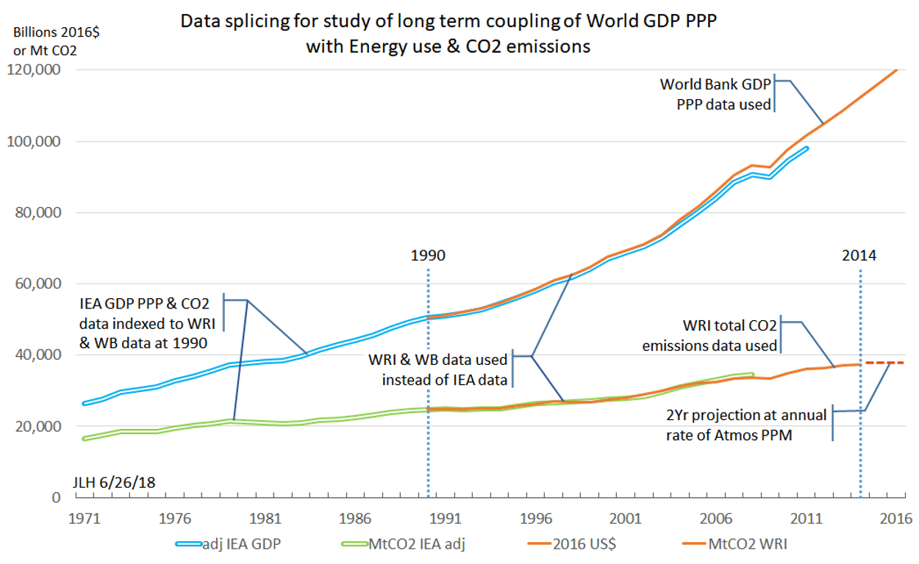
HDS Growth Constants and Warming
Jessie Henshaw

Slide 24
HDS Whole Systems Thinking
Jessie Henshaw
www.synapse9.com/signals sy@synapse9.com

